Slide 1
MINOR PROJECT
Team no : 65
- Under the guidance of Dr. P. Baby Maruthi
Team members:
Bharath Kumar N – ENG19CS0064
Chandrashekar V – ENG19CS0070
Chethan BS – ENG19CS0074
Chethan R – ENG19CS0075
Chethan Rao S – ENG19CS0076

Slide 2

AI BASED VIRTUAL MOUSE
TOPIC:

Slide 3
TABLE OF CONTENTS
01
Introduction
02
Problem definition
03
Objectives
04
Literature review
05
Module wise breakdown of project
06
Functional requirements
07
Design of the project

Slide 4
Introduction:
This project proposes a novel camera vision based cursor control system, using hand gestures captured from a webcam through a color detection technique.
Experimental setup of the system uses a fixed camera on a laptop, which captures snapshot using Red Green Blue [RGB] color space from fixed distance.
By this project we are aiming in creating a cost free hand recognition software for laptops and PCs with a web-cam support.
The project covers as a hand recognition tool which could be used to move the mouse pointer, perform simple operations like clicking and other hand gesture operations.

Slide 5
Problem Definition:
To design virtual mouse which detects hand gestures patterns instead of physical mouse. The camera is positioned such that it recognizes the moment of finger tips and performs the operations of mouse. The utilization of virtual mouse appears in space saving situations or in movement situation.

Slide 6
Objectives:
The goal is to manage computers and other devices with gestures rather than pointing and clicking a mouse or touching a display directly.
The system will allow the user to navigate the computer cursor using their hand gestures and left click and scrolling will be performed using different hand gestures.
To reduce the cost of hardware.

Slide 7
Literature Review:
Year | April 2021
Author | Prof. S. S. Jogdand, Neha Bhegade, Akanksha Lugade, Neha Marathe, Riza Sande
Tittle | Virtual Mouse using Hand Gestures
Methodology | Capturing real time video using Web-Camera. Converting the video captured into HSV format. Each image frame is processed separately. Conversion of each frame to a greyscale image. Calibrate the colour ranges. Calculate the image's centroid by locating the image's region. Tracking the mouse pointer. Simulating the mouse actions.
Key Findings | Human Computer Interaction, Python, Color Detection, Web camera, Hand Gestures.

Slide 8
Year | Oct 2021
Author | B. Nagaraj, J. Jaya,S. Shankar, and P. Ajay
Tittle | Deep Learning-Based Real-Time AI Virtual Mouse System Using Computer Vision
Methodology | The Camera Used in the AI Virtual Mouse System. Capturing the Video and Processing. (Virtual Screen Matching) Rectangular Region for Moving through the Window. Detecting Which Finger Is Up and Performing the Particular Mouse Function. Mouse Functions Depending on the Hand Gestures and Hand Tip Detection Using Computer Vision. For the Mouse to Perform Left Button Click. For the Mouse to Perform Right Button Click. For the Mouse to Perform Scroll up Function. For the Mouse to Perform Scroll down Function. For No Action to be Performed on the Screen
Key Findings | Human computer interaction · Color detection · Hand gestures · Virtual mouse

Slide 9
Module wise breakdown of project:
The project is divided into 2 sub-programs which is stored in 2 separate files:
Hand Tracking Module
AI Virtual Mouse Module
1. Hand Tracking Module :
The framework used is Mediapipe developed by google.
It uses two main models ,
Palm detection
hand landmarks

Slide 10
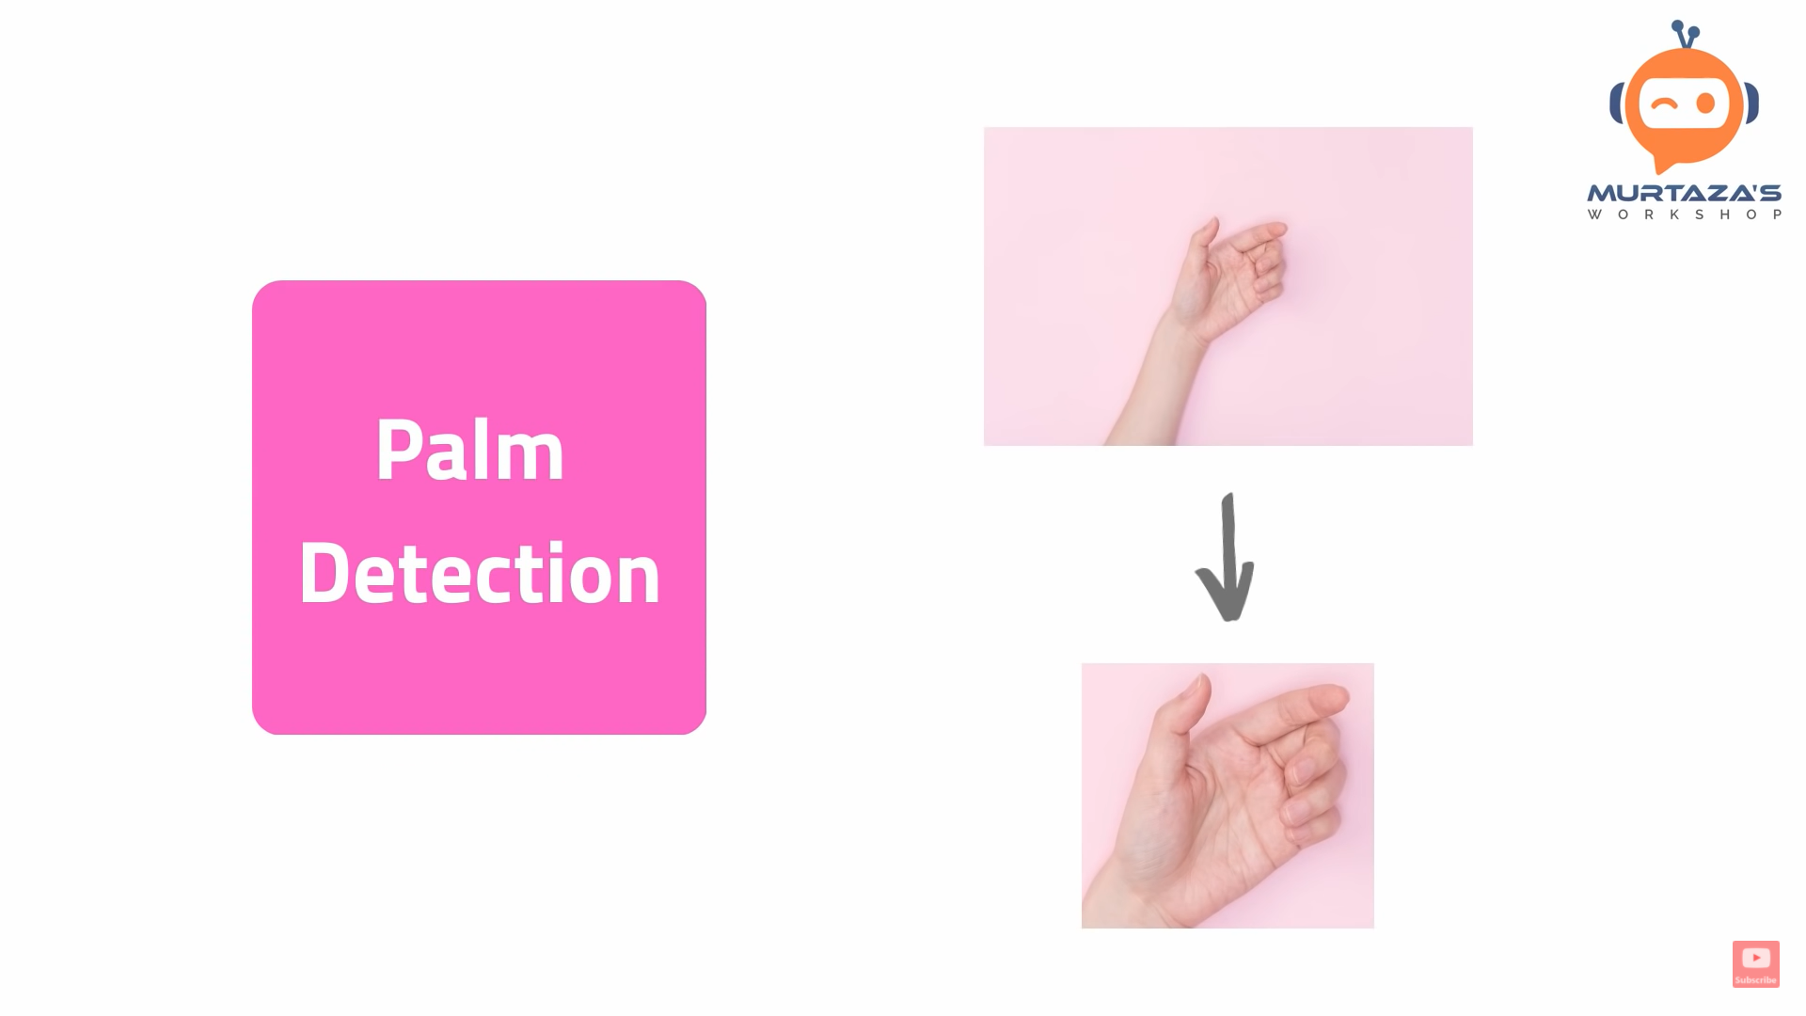
I. Palm Detection Model :
To detect initial hand locations, they designed a single-shot detector model optimized for mobile real-time uses.
Detecting hands is a decidedly complex task: their model has to work across a variety of hand sizes with a large scale span (~20x) relative to the image frame and be able to detect occluded and self-occluded hands.

Slide 11

II. Hand Landmark Model :
After the palm detection over the whole image our subsequent hand landmark model performs precise key point localization of 21 3D hand-knuckle coordinates inside the detected hand regions via regression, that is direct coordinate prediction.
The model learns a consistent internal hand pose representation and is robust even to partially visible hands and self-occlusions.

Slide 12
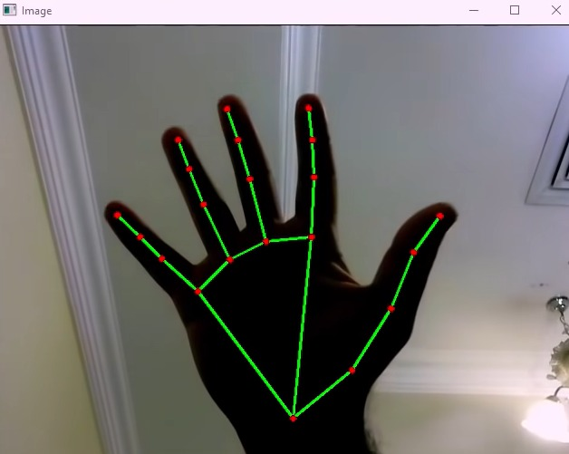
Steps in hand tracking module are :
i) Find Hands :
Converts captured image into RGB and send it to the mediapipe hands object to detect the hand.

Slide 13
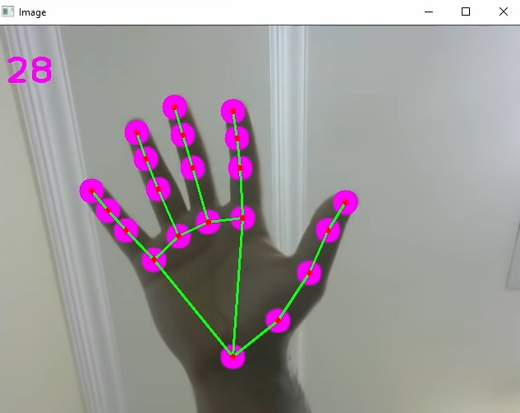
ii) Find Position :
Finding the position of all 21 landmarks and storing it in a list so that we can make use of it.

Slide 14
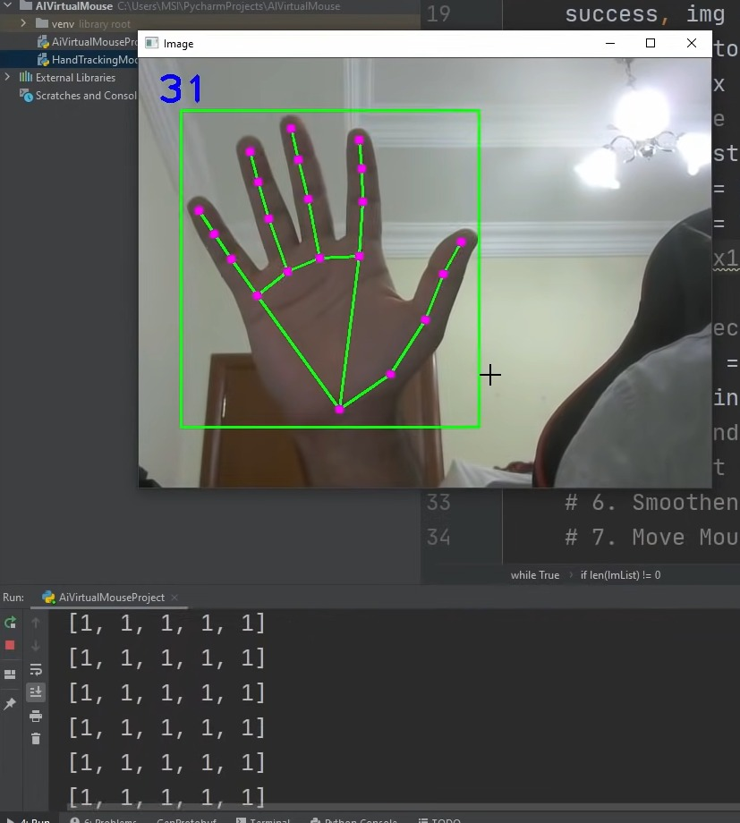
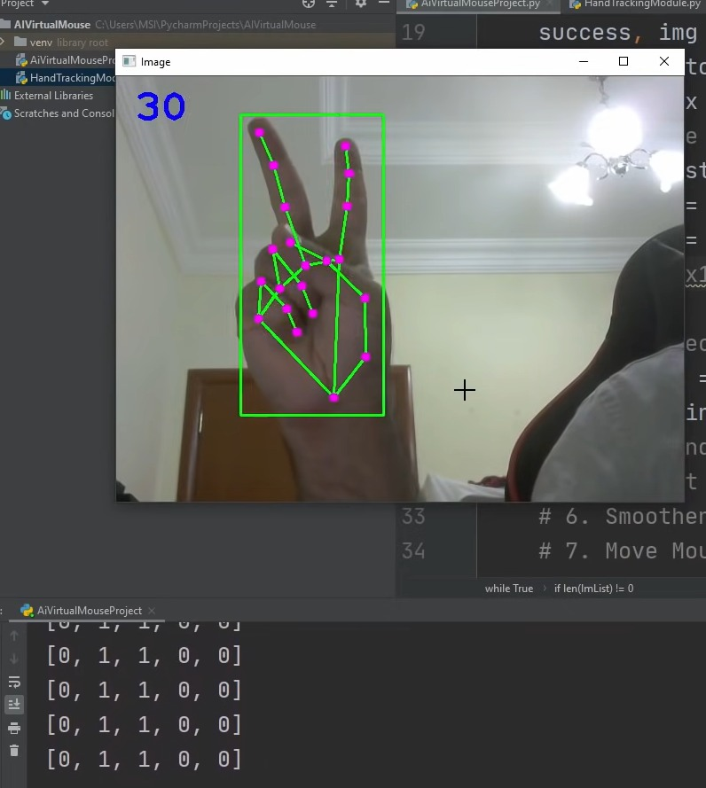
iii) Fingers Up:
Detecting which fingers are up.

Slide 15
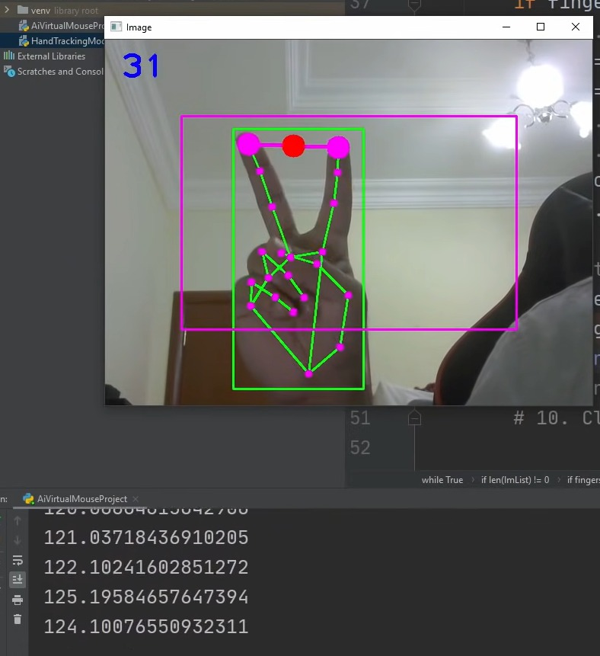
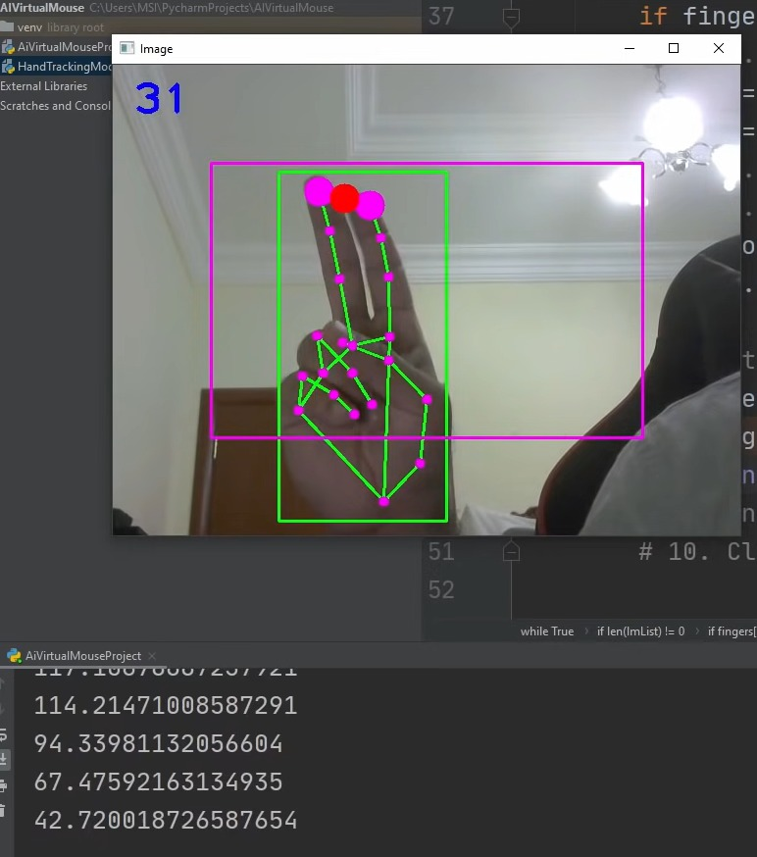
iv) Find Distance :
Finding the distance between index and middle finger.

Slide 16
2. AI Virtual Mouse Module :
Find hand Landmarks.
Check which fingers are up.
Only Index finger: Moving Mode.
Convert Coordinates.
Smoothen Values.
Move Mouse.
Both Index and middle fingers are up : Left click Mode.
Find distance between fingers.
Click mouse if distance short.
Both Index and thumb up: Scroll
All five fingers are up : right click mode
Frame rate.
Display.

Slide 17
Functional Requirements:
Software Requirements :
1. OPENCV : ( For image processing and drawing)
Open CV is the huge open-source library for the computer vision, machine learning, and image processing and now it plays a major role in real-time operation which is very important in today's systems..
2. AUTOPY : ( For controlling the mouse movement and click)
AutoPy is a simple, cross-platform GUI automation toolkit for Python, which includes functions for controlling the keyboard and mouse,
3. MEDIAPIPE : ( For Hand Tracking)
MediaPipe is an open-source, It can be used to make cutting-edge Machine Learning Models like Face detection, multi-hand tracking, object detection, and tracking, and many more.
4. NUMPY:
NumPy can be used to perform a wide variety of mathematical operations on arrays.

Slide 18
Functional Requirements:
Operations Performed :
1. Mouse movement : Using the index finger to move the mouse pointer.

Slide 19
2. Clicking: Bringing index finger and middle finger closer to perform click operation.
3. Scroll: Bringing index finger and thumb closer to perform scrolling.

Slide 20
Design of the project:
Algorithm
Step 1: Detect hands
Step 2: Detect Landmarks and store it in list
Step 3: Detect which fingers are up and store it in list
Step 4: If only index finger is up from step 3, go to step 5 else go to step 6
Step 5: Moving mode (autopy), go to step 3
Step 6: If both index and middle fingers are up from step 3, go to step 7 else go to step 9
Step 7: Calculate distance between 2 fingers. If distance is less than 40, go to step 8 else go to step 6
Step 8: Clicking mode (autopy), go to step 3
Step 9: If both index finger and thumb are up from step 3, go to step 10 else go to step 4
Step 10: Calculate distance between 2 fingers. If distance is less than 100, go to step 11 else go to step 9
Step 11: Scrolling mode, go to step 3

Slide 21
Capture a real time video using web-camera
Not Found
Hand Detection
Flow Chart
Fingers Up
No
Only Index Finger
Yes
Mouse Movement
No
Index & Middle Finger(Closer)
Yes
Click
No
Index & Thumb (Closer)
Yes
Scroll
No

Slide 22
Software Requirements Specification (SRS Document)
Introduction :
1.1 Purpose (start by defining the purpose of your product)
The goal is to manage computers and other devices with gestures rather than pointing and clicking a mouse or touching a display directly.
The system will allow the user to navigate the computer cursor using their hand gestures and left click and dragging will be performed using different hand gestures.
The hand gesture is the most effortless and natural way of communication. The output of the camera will be displayed on the monitor.
To reduce the cost of hardware.
1.2 Intended Audience
This project improvise the interaction between the machine and humans. This system is mainly aimed to reduce the use of hardware components attached with the computer. Controlling the mouse with hand gestures will be helpful to the users while doing presentations in a conference. It can also be used in gaming or any other independent application.

Slide 23
1.3 Intended Use
By this project we are aiming in creating a cost free hand recognition software for laptops and PCs with a web-cam support.
The project covers as a hand recognition tool which could be used to move the mouse pointer, perform simple operations like clicking and other hand gesture operations.
1.4 Scope or Product scope
Virtual Mouse that will soon to be introduced to replace the physical computer mouse to promote convenience while still able to accurately interact and control the computer system. To do that, the software requires to be fast enough to capture and process every image, in order to successfully track the user's gesture. Therefore, this project will develop a software application with the aid of the latest software coding technique and the open-source computer vision library also known as the OpenCV.
The scope of the project is as below:
1. Real time application.
2. User friendly application.
3. Removes the requirement of having a physical mouse.

Slide 24
2. Overall Description:
2.1 User Needs
AI virtual mouse is an advanced technology where there is no need to touch the device. User should make sure that the web-cam is connected and is working properly.
3. System Features and Requirements:
3.1 Functional Requirements
After developing this application user should be able to access their system through Virtual Mouse. Calculations required for this application is all related to motion detect operations & Data processing is done by using different python libraries like NumPy & media-pipe.
3.2 External Interface Requirements
Software requirement:
1. Operating system
2. Jupyter notebook
Modules used:
1. opencv
2. mediapipe
3. autopy
Hardware requirement:
1. 4gb ram 2. web-cam

Slide 25
3.3 System Features
This project presents finger movement gesture detection on our computer’s window using camera & handling the whole system by just moving your one finger. Using finger detection methods for instant camera access and user-friendly user interface makes it more easily accessible. The system is used to implement motion tracking mouse, a signature input device and an application selector. This system reduces the use of any physical mouse which saves time and also reduces efforts.
Following are the operations that can be performed:
Mouse movement :
Using the index finger to move the mouse pointer.
Clicking:
Bringing index finger and middle finger closer to perform click operation.
Scrolling:
Bringing index finger and thumb closer to perform scrolling.

Slide 26
Thank you..

